Slide 1
GROUP 4
B Dileep – 093940
MVNS Prathyusha – 093984
Rohit Hurkadli – 094048
Navya Rani – 093953
K Mahantesh - 093957

Slide 2
INDEX
Fundamentals of Hardware
Windows Fundamentals
Linux Fundamentals
Network Fundamentals
Network Services
Database Fundamentals
Applications
Storage

Slide 3
Fundamentals Of
Hardware

Slide 4
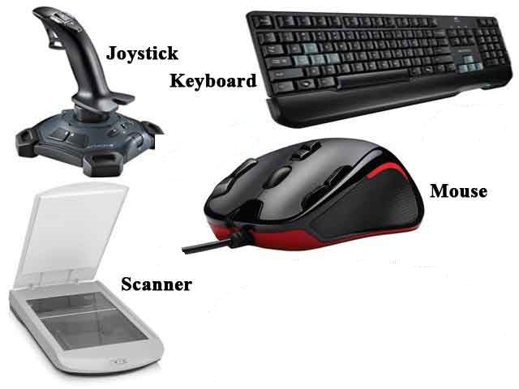
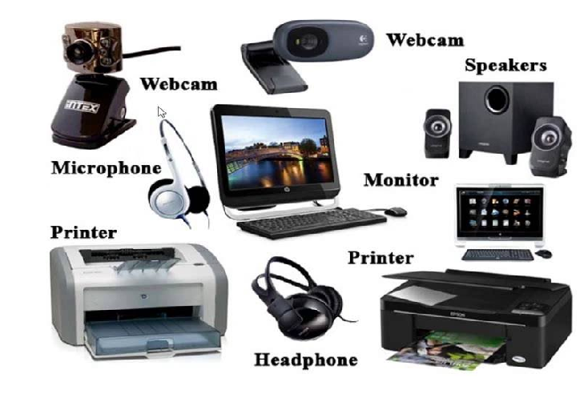
INPUT AND OUTPUT DEVICES
Input Devices
Output Devices

Slide 5
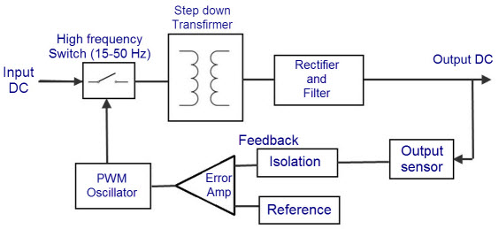
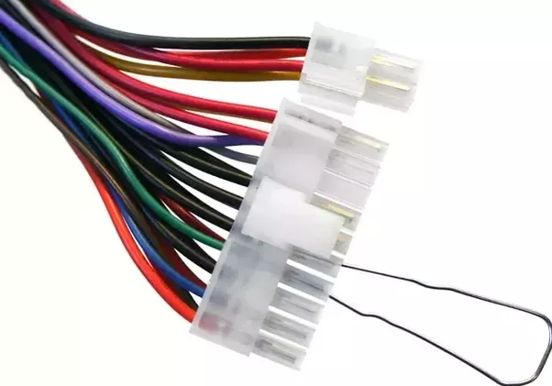
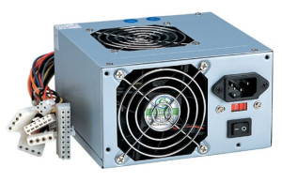
SWITCHED MODE POWER SUPPLY(SMPS)

Slide 6
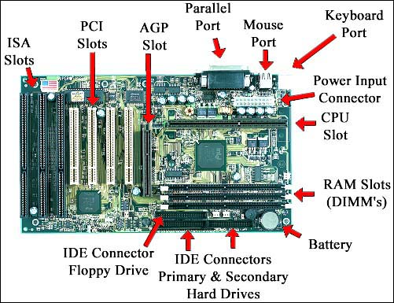
MOTHERBOARD

Slide 7
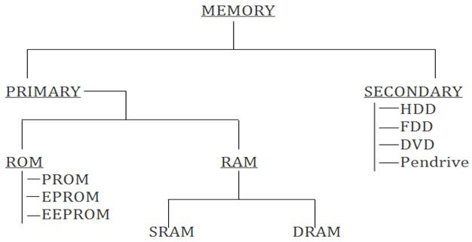
MEMORY AND IT’S TYPES

Slide 8
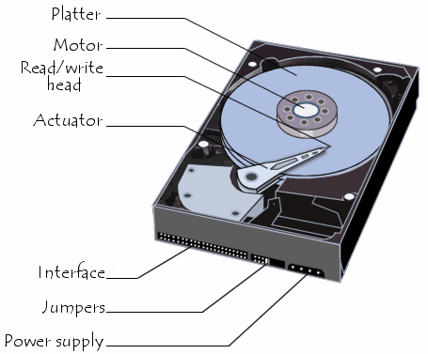
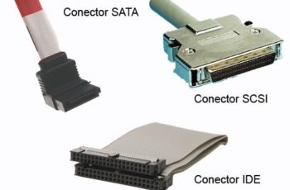
HARDDISK

Slide 9
WINDOWS FUNDAMENTALS

Slide 10
INTRODUCTION TO OS
An operating system or OS is a software program that enables the computer hardware to communicate and operate with the computer software.
Without a computer operating system, a computer and software programs would be useless.
Types of operating Systems :
Network Operating System
Real Time Operating System
Distributed Operating System
Multi tasking Operating System
Embedded Operating System

Slide 11
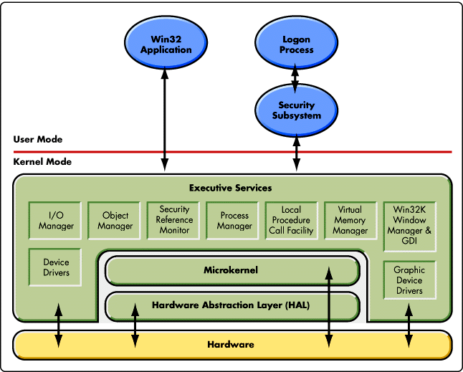
Windows Kernel and Architecture

Slide 12
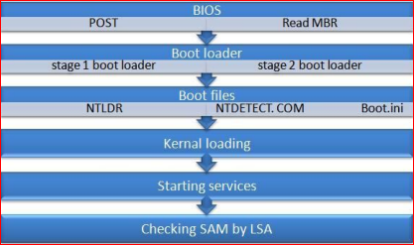
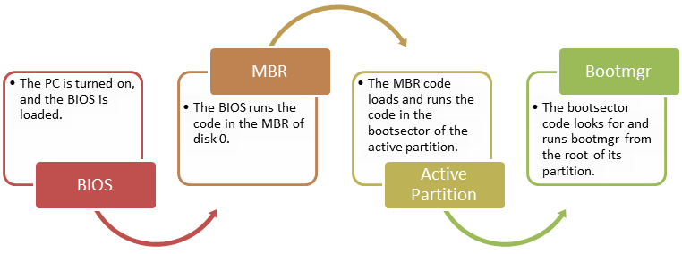
BOOTING PROCESS

Slide 13
Windows File System
The structure and logic used to manage the groups of information is called a "file system".

Slide 14
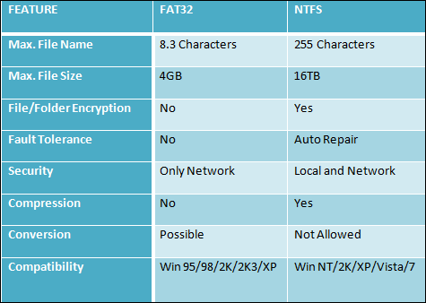
Comparison between NTFS & FAT

Slide 15
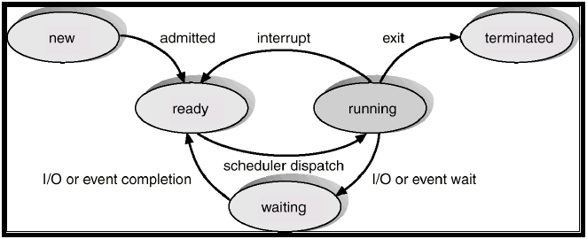
Process Management
Process Types:
Multi processing
Multi tasking
Multi threading
Hyper threading
Process State Diagram

Slide 16
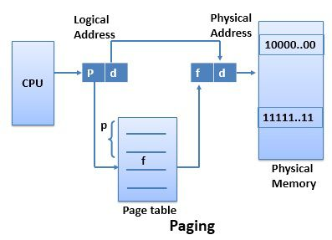
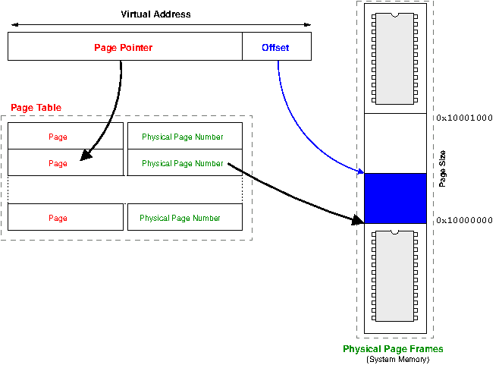
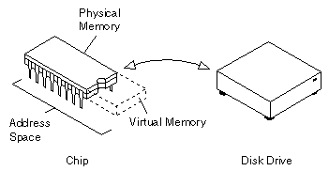
Memory Management
Virtual Memory
Virtual Address Space

Slide 17
LINUX FUNDAMENTALS

Slide 18

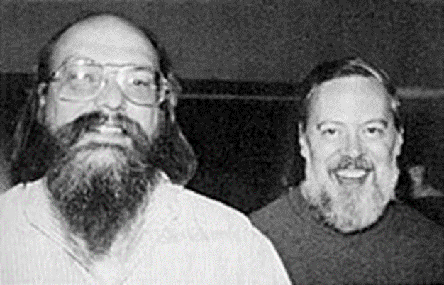


History of Linux
The Unix operating system was developed by Ken Thompson and Dennis Ritchie at
AT & T Bell LAB in 1969 and released in 1970.

Slide 19
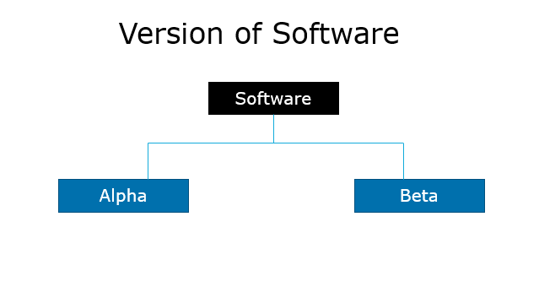
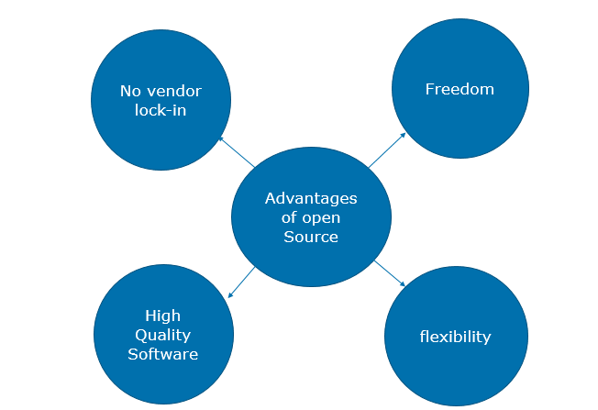
Software

Slide 20
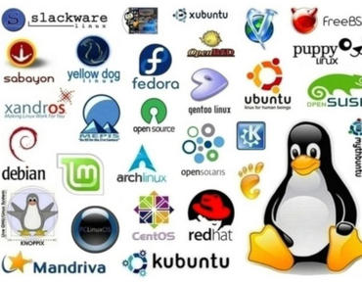
Distribution of Linux

Slide 21
Linux Subsystem
LINUX
USER APPLICATION
OS SERVICES
HARDWARE CONTROL
LINUX KERNEL

Slide 22
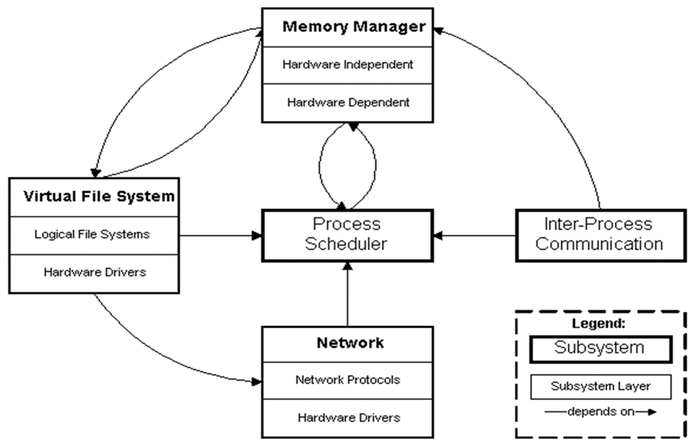
Kernel Subsystem

Slide 23
Booting process
Power/On
BIOS
MBR
GRUB
RUNLEVEL
INIT
KERNEL

Slide 24
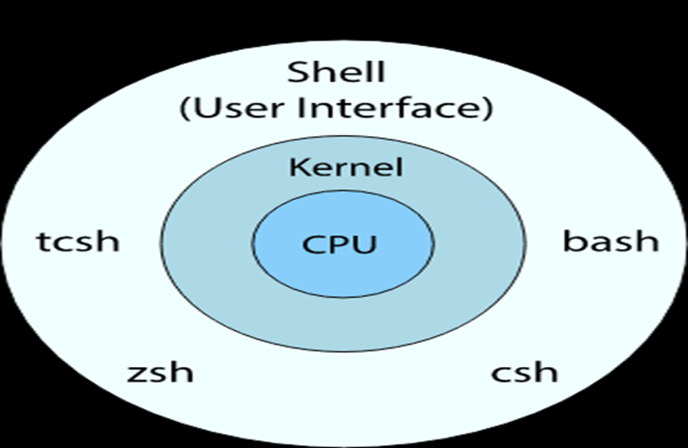
SHELL
Types of shell
Ash
Bourne
Bash
Corn
T-shell
C-shell
Z-shell

Slide 25
Run-levels
0-Halt
1-Single User mode
2-Multiuser mode without Network
3-Full multiuser mode
4-Unused
5-GUI
6-Reboot

Slide 26
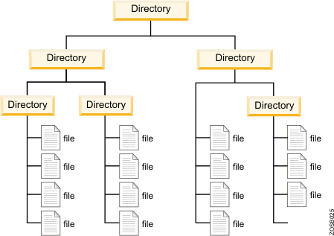
FILE SYSTEM
TYPES OF LINUX FILE SYSTEM
Ext 2
Ext 3
Ext 4
TYPES OF JOURNALING
Write back
Ordered
Data

Slide 27
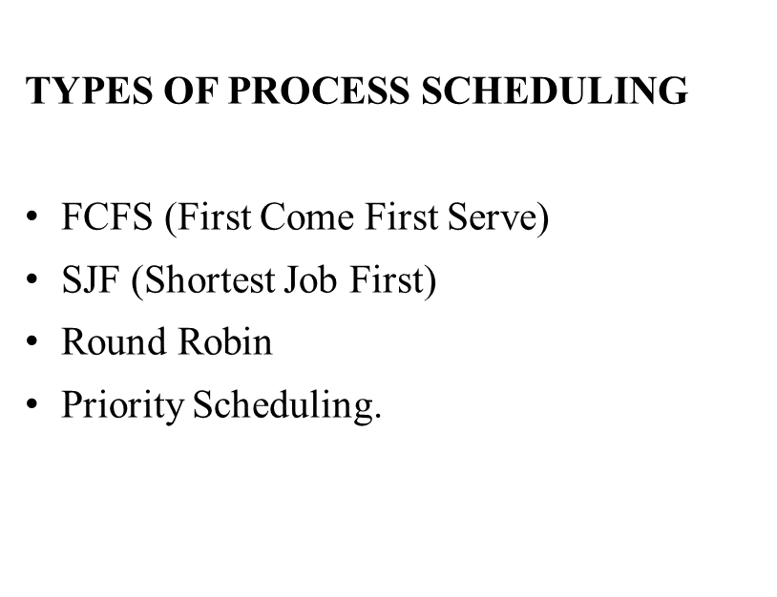
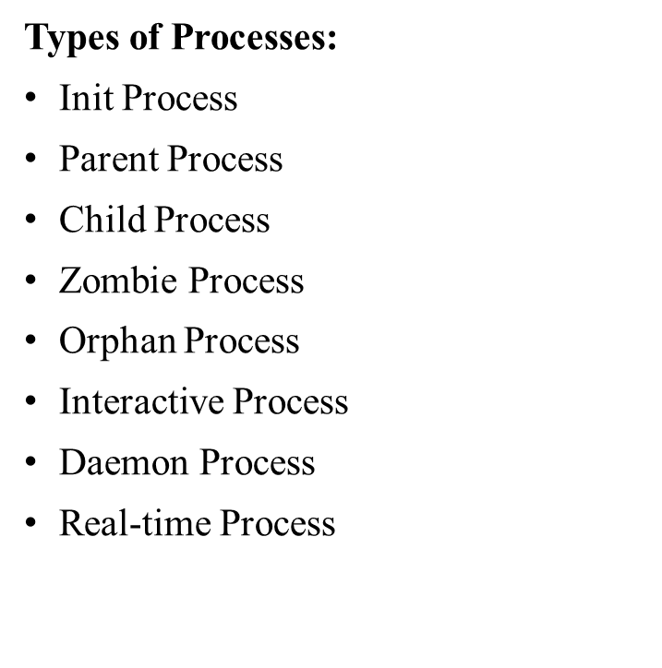
Process Management

Slide 28
DEVICE MANAGEMENT
Device files(/dev)
IRQ
Device Files
Character Devices
Block Devices

Slide 29
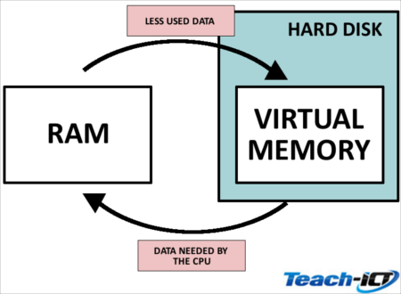
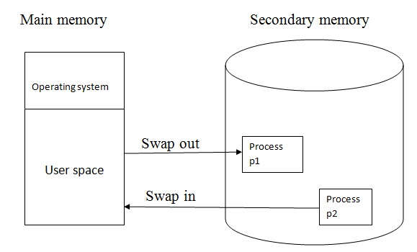
Memory Management
Virtual memory
Memory swapping
Memory Management Algorithms
BUDDY Algorithm
LRU

Slide 30
NETWORK FUNDAMENTALS

Slide 31
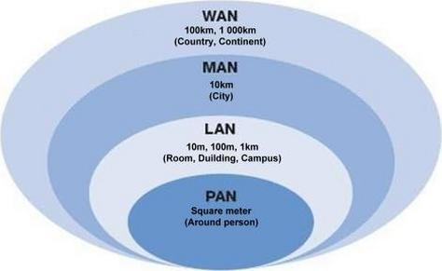
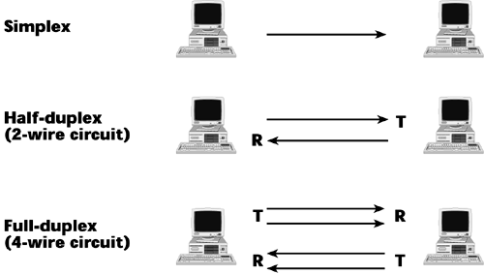
NETWORK
TYPES OF NETWORK: COMMUNICATION TYPES:

Slide 32
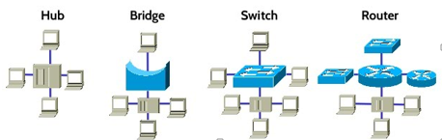
Network Devices

Slide 33
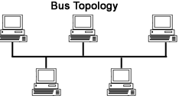
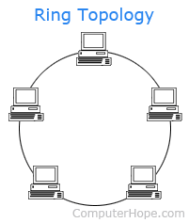
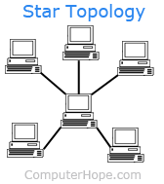
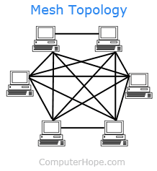
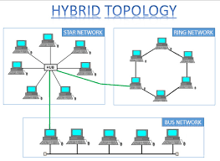
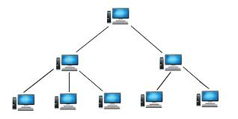
NETWORK TOPOLIGES
Tree Topology

Slide 34
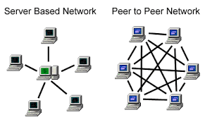
NETWORK ARCHITECTURE

Slide 35
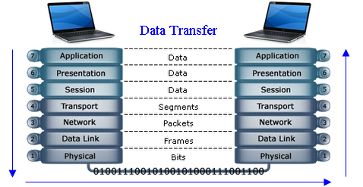
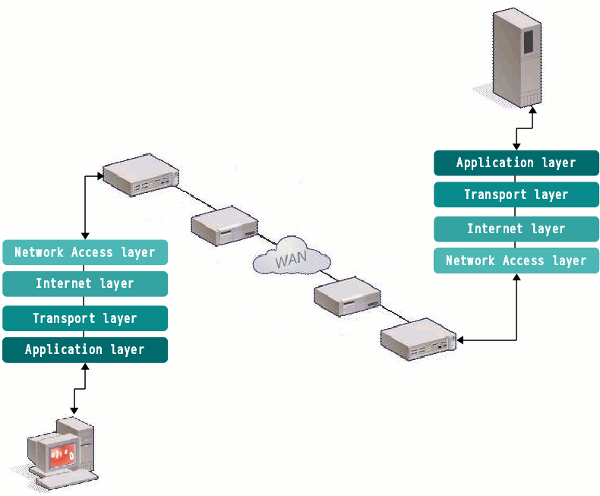
OSI MODEL
TCP/IP MODEL

Slide 36
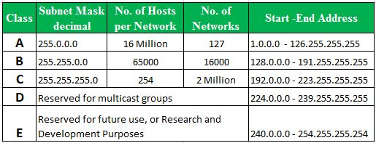
IP ADDRESS CLASSES
An IP address, short for Internet Protocol address, is an identifying number for a piece of network hardware. Having an IP address allows a device to communicate with other devices over an IP-based network like the internet.
Sub netting: Sub netting allows you to create multiple logical networks that exist within a single Class A, B, or C network. If you do not subnet, you are only able to use one network from your Class A, B, or C network, which is unrealistic.

Slide 37
Network Services

Slide 38
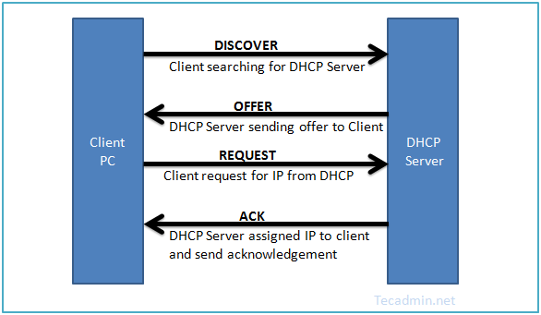
DHCP(Dynamic Host Configuration Protocol)
It is used for automatic configuration of client network services.

Slide 39
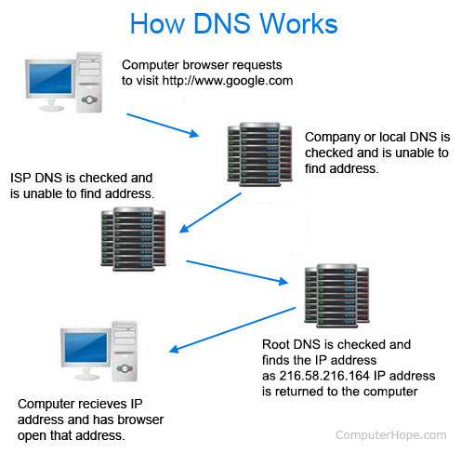
DNS(Domain Name Server)
It translates internet domain and host names to IP addresses.
1.DNS Records
2.DNS Client side Caching
3.DNS Hierarchy

Slide 40
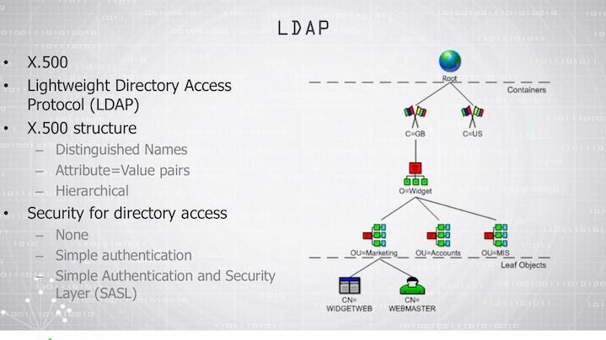
Directory Services
It is a database that contain information about all objects on the network.
LDAP
1.Information Model
2.Naming Model
3.Functional Model
4.Security Model

Slide 41
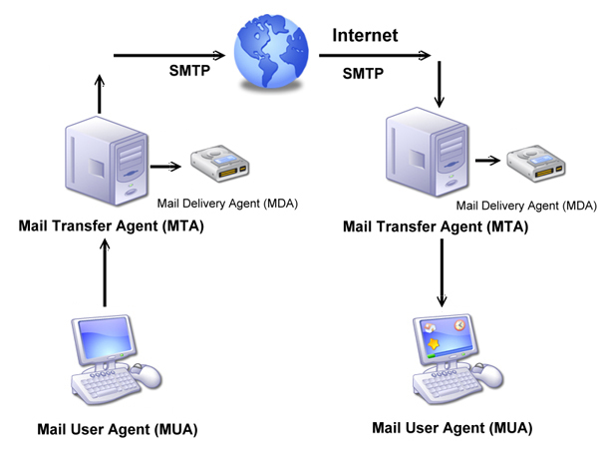
Mail Services

Slide 42
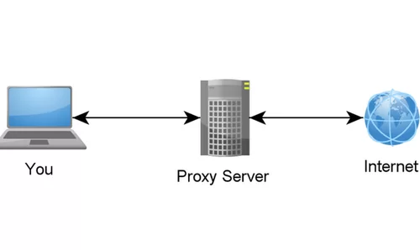
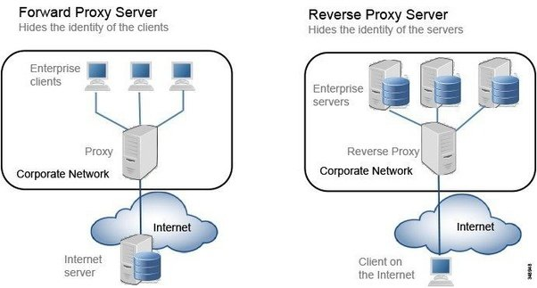
Proxy Service
It Performs actions between client(user) and Server(Internet).

Slide 43
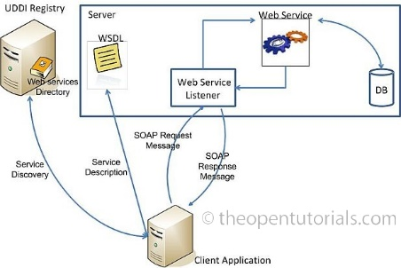
Web Service

Slide 44
Fundamentals Of
Database

Slide 45
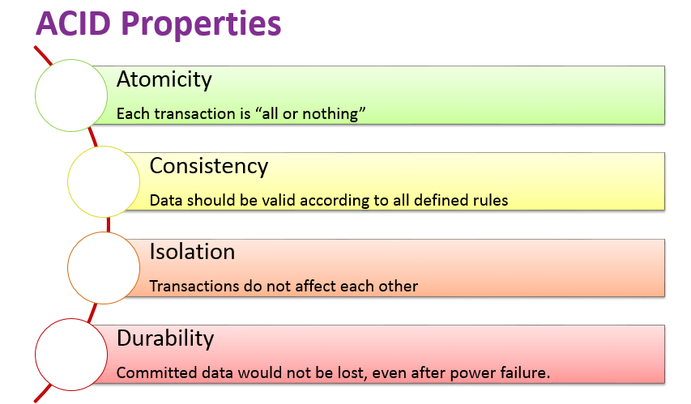
Database
A database is a collection of information that is organized so that it can be easily accessed, managed and updated.

Slide 46
EF Codd Rules:
Structural Rule
Rule 1: Rule of Information
Rule 6: Rule of Updating Views
Integrity Rule
Rule 3: Rule of Systematic Null Value Support
Rule 10: Rule of Integrity Independence
Data Manipulation Rule
Rule 2: Rule of Guaranteed Access
Rule 4: Rule of Active and online relational Catalog
Rule 5: Rule of Comprehensive Data Sub-language
Data Independence Rule
Rule 8: Rule of Physical Data Independence
Rule 9: Rule of Logical Data Independence
Rule 11: Rule of Distribution Independence
Foundational Rule
Rule 12: Rule of Non Subversion
Rule 0: Foundation rule

Slide 47
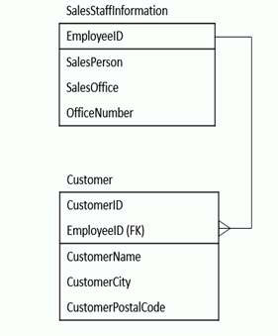
Normalization
Normalization is a method for organizing data elements in a data base into tables
1 NF 2 NF 3 NF

Slide 48
APPLICATIONS

Slide 49

APPLICATION PROGRAMMING INTERFACE(API)
An application program interface (API) is code that allows two software programs to communicate with each other.
TYPES OF APPLICATION:

Slide 50


TIER ARCHITECTURE
APPLICATION SECURITY:
Application security is the use of software, hardware, and procedural methods to protect applications from external threats.

Slide 51


APPLICATION ARCHITECTURE TYPES:
Thick Client Architecture
Thin Client Architecture
Rich Internet Application

Slide 52
STORAGE
STORAGE
FUNDAMENTALS

Slide 53

STORAGE AND TYPES
Storage is a process through which digital data is saved within a data storage device by means of computing technology.
Types of Storage :
Logical Unit Number
Zoning
iSCSI

Slide 54



RAID (Redundant Array Of Independent Disks)

